Slide 1

competitive landscape
Project 2
Augusto Eira, Bárbara Muniz and Gonçalo Calvinho

Slide 2

Goals:
Create and populate a database;
Design queries that answer the business questions of interest.
Requirements:
Elaborate a main business question related to Ironhack’s students review;
Create SQL queries;
Run queries using Python connectors.
About the project

Slide 3

Main Scope
Ironhack's Performance Appraisal
Client: Ironhack

Slide 4
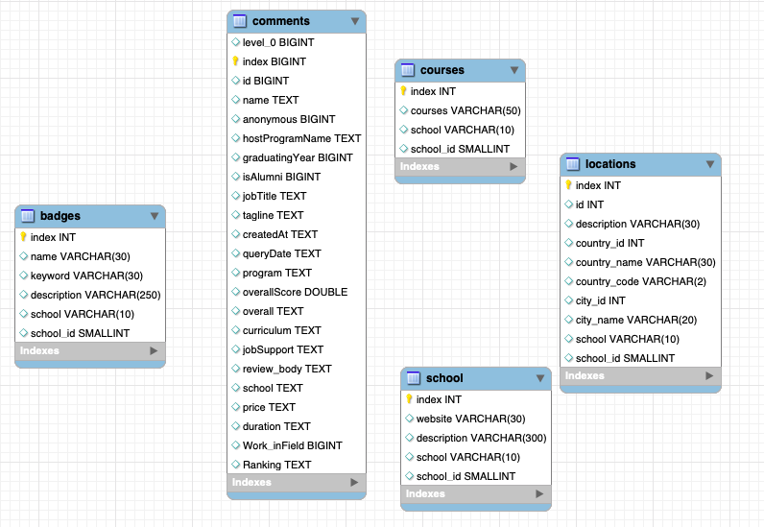
ER Diagram
Notes:
Criamos mais 3 colunas (duas funções)
Limpamos a tabela -- jobTitle – criamos (5 funções); removemos nulos e espaços, substituimos

Slide 5


Queries
Students from which format rate Ironhack the most?
Do price/duration of course influence in the evaluation?
How was Ironhack evaluated throughout time?
What is the profile of the students who evaluate Ironhack the most?
How students who work in the field evaluate Ironhack?
Notes:
Top 5 tech schools that have the same courses as Ironhack

Slide 6

Aspects evaluated:
Program;
Overall Score
Conclusions:
Best rate: Web Development;
Worst rate: Data Analytics
Which students better rate Ironhack?

Slide 7

Aspects evaluated:
Price;
Duration;
Overall Score (Ranking)
Conclusions:
Students who pay less (Full-Time) gave a higher review;
Do price/duration of course influence in the evaluation?

Slide 8

Years assessed: 2017 – 2021
Aspects evaluated:
Overall Score,
Job Support,
Curriculum
Conclusions:
Small decrease of curriculum/job support reviews;
Curriculum is the strongest aspect
How was Ironhack evaluated throughout time?

Slide 9
Aspects evaluated:
Program,
Alumni (or not),
Work in the Field
Conclusions:
Full-Time: Web Development, UX/UI Design;
Part-Time: Web Development
Alumni evaluate more than current students;
What is the profile of the students who evaluate Ironhack the most?
Notes:
Alumni who dont work in the field made more reviews, however data for the other student profiles were not sufficient

Slide 10
Focus: Students (Non-Alumni) who work in the field
Aspects evaluated:
Overall Score,
Curriculum,
Job Support
Conclusions:
Lack of data.
How students who work in the field evaluate Ironhack?

Slide 11

Product
Automatic report sent with updated data

Slide 12


Analytical Improvements
Compare with other schools
BI tools to better visualize data
More data on Cyber Security courses
More data on career boosters
Notes:
DA Curriculum and Overall Improvement – onde Ironhack apresentou os piores resultados
Attention to the Job Support – uma que está caindo desde 2017

Slide 13
Technical Improvements
Use NLP to assess sentiment analysis
Automatic update of data visualization
Increase credentials security
Warning report sending via Slack
Notes:
DA Curriculum and Overall Improvement – onde Ironhack apresentou os piores resultados
Attention to the Job Support – uma que está caindo desde 2017

Slide 14
Thank you!
More info:
github.com/calvinhus/sql_project
bnbmuniz@gmail.com
Eira.augusto.jr@gmail.com
gjpcalvinho@gmail.com

